Slide 1
This is my father’s world
Do your own research,
Come to your own conclusions
Suggested books:
Dinosaur!, Carl E. Baugh
Tornado in a Junkyard, James Perloff
The Genesis Record, Henry Morris
Suggested websites:
www.trueauthority.com/cvse/radiometric.htm www.answersingenesis.org
www.creationrevolution.com
Notes:
Psalm 104:6, terraforming

Slide 2
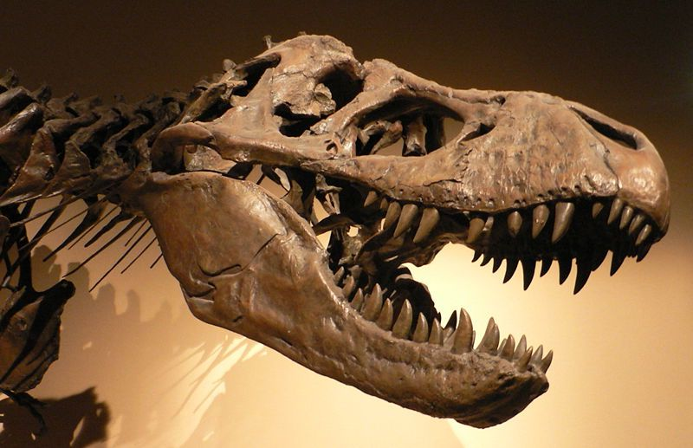
This is my father’s world
The story of
behemoth
How dinosaurs lived and died
Notes:
Psalm 104:6, terraforming

Slide 3
“What about the dinosaurs?”
Dinosaurs “prove” evolution by …
  Showing God allowed part of His creation to become extinct
  Requiring millions of years for natural processes to create the fossil record
  Discrediting the Bible, which says nothing about humans and dinosaurs living together
The first is already discredited; the others are similarly flawed arguments
Notes:
Why do dinosaurs “prove” evolution?
Animals far older than the Bible allows
Bible would discuss animals that dominant

Slide 4
Dinosaurs were real
They were created (Exodus 20:11) and saved (Genesis 7:8) along with everything else
Thousands of them are preserved in fossils
The flood – the ultimate “catastrophe” or “extinction event” – made it impossible for them to survive as before
Notes:
Why do dinosaurs “prove” evolution?
Animals far older than the Bible allows
Bible would discuss animals that dominant

Slide 5
Million-year epochs are not
Dating methods are flawed
  A “mother” element (uranium, potassium, etc.) decays and forms a “daughter” element (lead, argon, etc.)
  The decay rate is assumed constant
  All the daughter is assumed to come from the mother
  “Leakage” is assumed not to have occurred
  “Wrong” results scrapped, “right” ones kept

Slide 6
Million-year epochs are not
Whatever testing can be done shows the unreliability of the process
  Living shells dated 27,000 years old
  Fresh-killed seal dated 1,300 years old
  Mt. St. Helens lava dome 2.8 million years old
  Richard Leakey’s “skull 1470” found in strata dated at 200 million years and 2.6 million years before scientists settled on an “acceptable” date of 1.8 million years

Slide 7
Million-year epochs are not
Eons of time are essential for slow, invisible evolution to change one species into another
If dinosaurs and humans lived simultaneously, it would obliterate Darwin’s theory beyond recovery

Slide 8
Million-year epochs are not
  “Such an association would dispel an Earth with vast antiquity. The entire history of creation, including the day of rest, could be accommodated in the seven biblical days of the Genesis myth. Evolution would be vanquished.“
  (Louis Jacobs, In Quest of the African Dinosaur, p. 261)

Slide 9
Bible: We walked together
Remember, we are looking for dinosaur the animal, not dinosaur the word!
God created “beasts of the earth” (Genesis 1:24) and “man in His own image” (Genesis 1:27) on the same day
God wants us to examine His creation to learn about Him and ourselves (Proverbs 30:29-31; Job 39)

Slide 10
Bible: We walked together
“Behold now, Behemoth, which I made as well as you; he eats grass like an ox. Behold now, his strength in his loins and his power in the muscles of his belly. He bends his tail like a cedar; the sinews of his thighs are knit together. His bones are tubes of bronze; his limbs are like bars of iron. He is the first of the ways of God …” (Job 40:15-19)

Slide 11
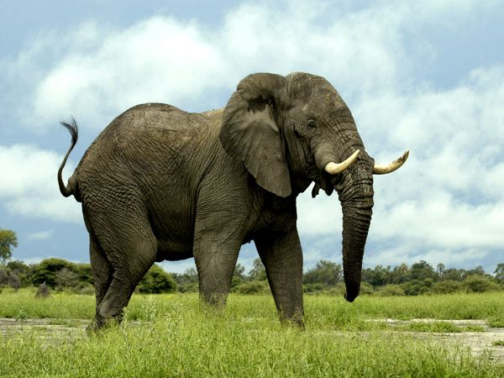
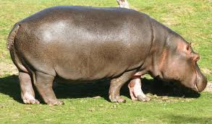
Bible: We walked together
“His strength in his loins and his power in the muscles of his belly”? Maybe.
“His bones are tubes of bronze; his limbs are like bars of iron”? Maybe.
But, “He bends his tail like a cedar”?

Slide 12
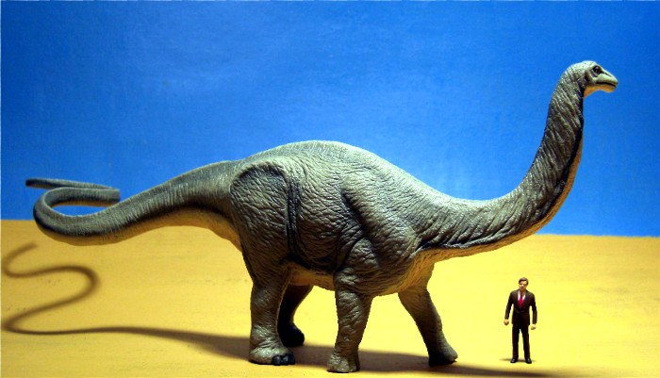
Bible: We walked together
“His strength in his loins and his power in the muscles of his belly”? YES!
“His bones are tubes of bronze; his limbs are like bars of iron”? YES!
“He bends his tail like a cedar”? YES!

Slide 13
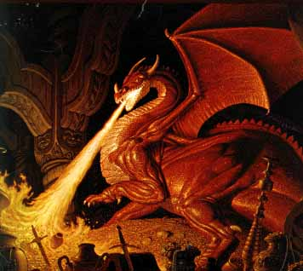
Bible: We walked together
“Can you draw out Leviathan with a fishhook, or press down his tongue with a cord? … Out of his mouth go burning torches; sparks of fire leap forth. Out of his nostrils smoke goes forth as from a boiling pot and burning rushes. His breath kindles coals, and a flame goes forth from his mouth.” (Job 41:1,19-21)

Slide 14
Bible: We walked together
“You divided the sea by Your strength; You broke the heads of the sea monsters [dragons, KJV] in the waters. You crushed the heads of Leviathan; You gave him as food for the creatures of the wilderness.” (Psalm 74:13-14)

Slide 15
Bible: We walked together
“In that day the Lord will punish Leviathan the fleeing serpent, with His fierce and great and mighty sword, even Leviathan the twisted serpent; and He will kill the dragon who lives in the sea.” (Isaiah 27:1)

Slide 16
Bible: We walked together
The Bible also mentions …
  “Flying serpent” (Isaiah 14:29)
  “Fiery serpents” (Numbers 21:6; Deuteronomy 8:15)
  “Cockatrice” (Isaiah 11:8, 14:29; Jeremiah 8:17)
  People in Bible times, even King James’ time, did not consider these creatures “mythological”!

Slide 17
“Which way did they go?”
Post-flood would have made it almost impossible for super-large dinosaurs to survive
Men no doubt hunted them (Genesis 9:3) for food, survival or glory
Volcanic activity and the removal of the canopy likely caused “the Ice Age,” which was not suited to reptiles
Notes:
including a large quadruped armed with a heavy neck frill and up to four horns on its head. Our witnesses immediately picked out a picture of the triceratops as being a dead ringer for this animal which is reputed to kill and disembowel elephants

